Slide 1

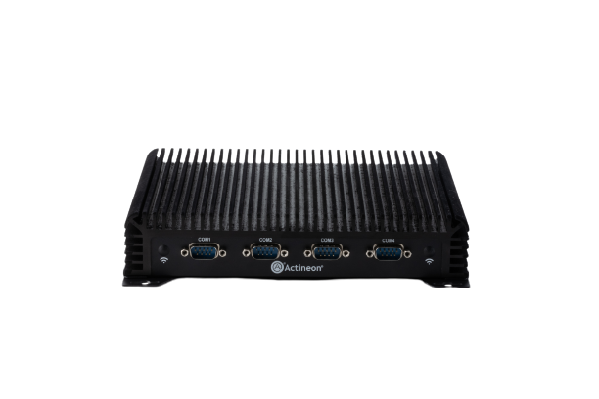
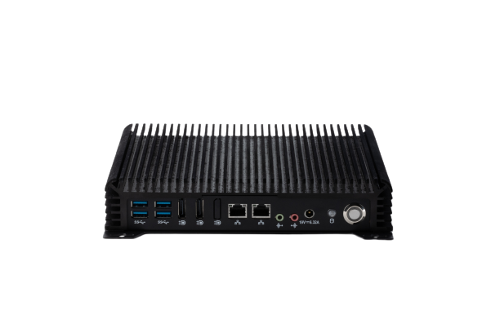
Purpose Built Computers For Professional Deployments
Siilent 11H2
Product Overview
Primary Applications
Outdoor Digital Signage
Kitchen Display System (KDS)
Menu Boards
IoT Edge Gateway Device
Key Features
Supports 8th and 9th Generation Intel Core Processor up to i7
Up to 64GB DDR4 RAM
Up to 2TB M.2 SSD
4x USB 3.0 ports
Up to 4x Serial ports
2x DisplayPort++
2x RJ45 Gigabit Ethernet port
Optional WiFi/Bluetooth
Supports Windows & Linux
All Solid-State and Fanless Operation
Durable Die-Cast Aluminum Alloy + Aluminum Sheet Metal
VESA Mounting Pattern (200mm square)
Small Form Factor: 7.5(W) x 6.2(D) x 1.5(H)​ inches
Customization available upon request

